Slide 1

House Price Prediction using Machine Learning
Advanced Apex Project
Data Disruptors
Dr. Naga Janapati

Slide 2
The Challenge
Every house sale raises the same question: "Is this the right price?"
The Problem:
Buyers want fair deals
Sellers want accurate valuations
Real estate agents need quick estimates
Banks need reliable appraisals
Our Mission: Build an AI model that predicts house prices with 90%+ accuracy using property features.

Slide 3
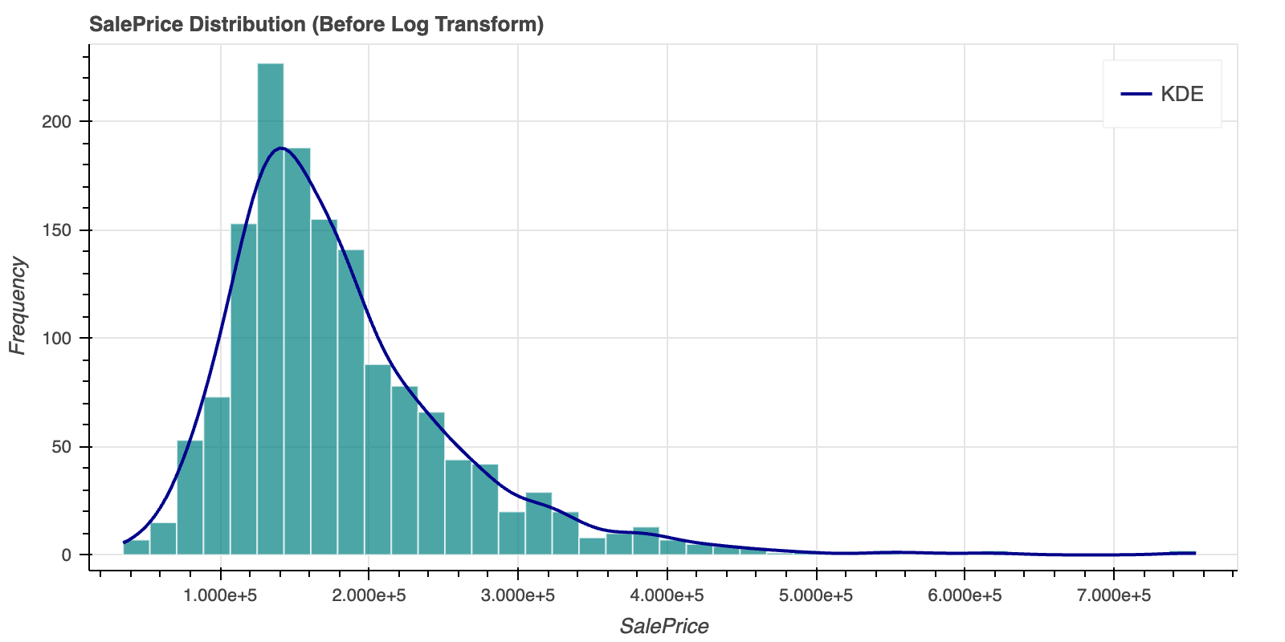
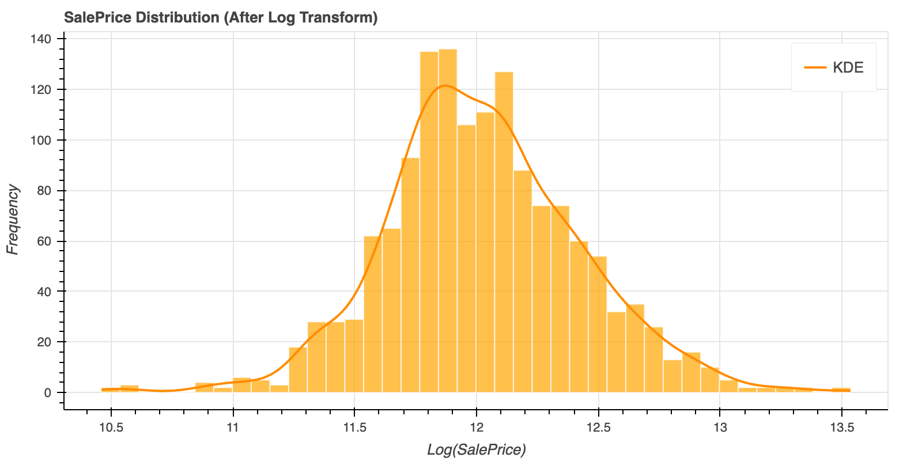
Why we need prediction?
The before/after comparison visually demonstrates that log transformation converts the right-skewed price distribution into a normal distribution, which is essential for accurate regression modeling.

Slide 4
The Data
Shape of dataset: (1460, 81)
1,460 Houses, 81 Features, One Goal
Dataset: Kaggle House Prices Competition (Ames, Iowa)
What We Have:
1,460 real property sales
81 features: size, quality, location, age, amenities
Target: SalePrice (ranging from $34,900 to $755,000)
The Challenge:
Missing values in 19 columns
Outliers in 32 numeric features
Mix of categorical and numerical data
- Skewed price distribution
Data types of each column:
Id int64
MSSubClass int64
MSZoning object
LotFrontage float64
LotArea int64
...
MoSold int64
YrSold int64
SaleType object
SaleCondition object
SalePrice int64
Length: 81, dtype: object

Slide 5
The Discovery Journey
What Drives House Prices?
Key Insights from EDA:
Size Matters Most
Total Square Footage is the #1 predictor (68% mutual information score)
Living area, basement, and floors all correlate strongly
2. Quality Over Location
Overall Quality (58% MI score) beats neighborhood
Quality Score (quality × condition) is a powerful predictor
3. Price Patterns
Average price varies 3.4x across neighborhoods ($98K to $335K)
Quality rating (1-10) shows clear price progression
Log transformation needed (skewness: 1.88)

Slide 6
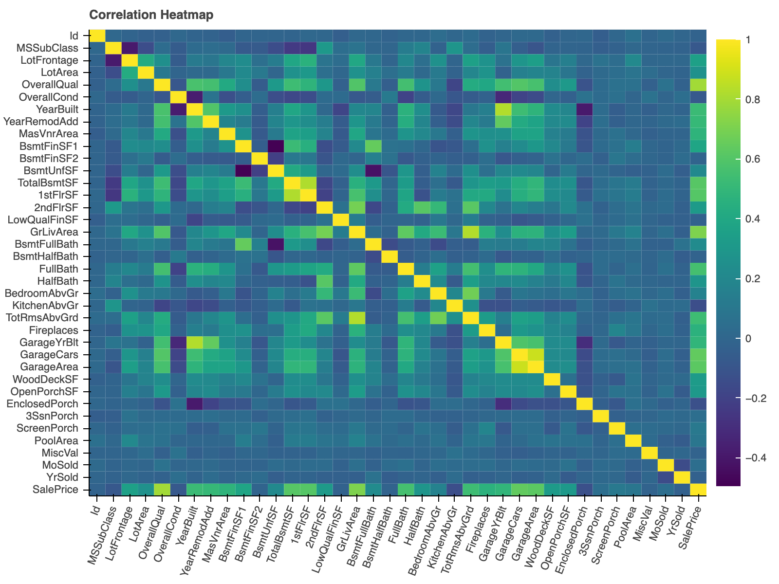
The correlation heatmap reveals feature relationships and identifies the strongest price predictors (like OverallQual and GrLivArea) while detecting redundant features.

Slide 7
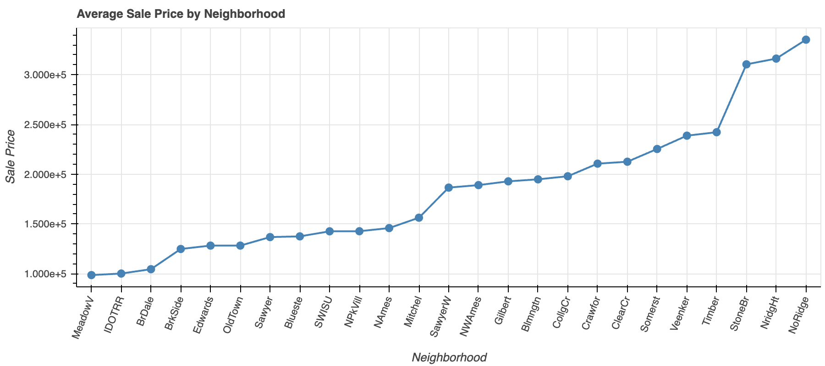
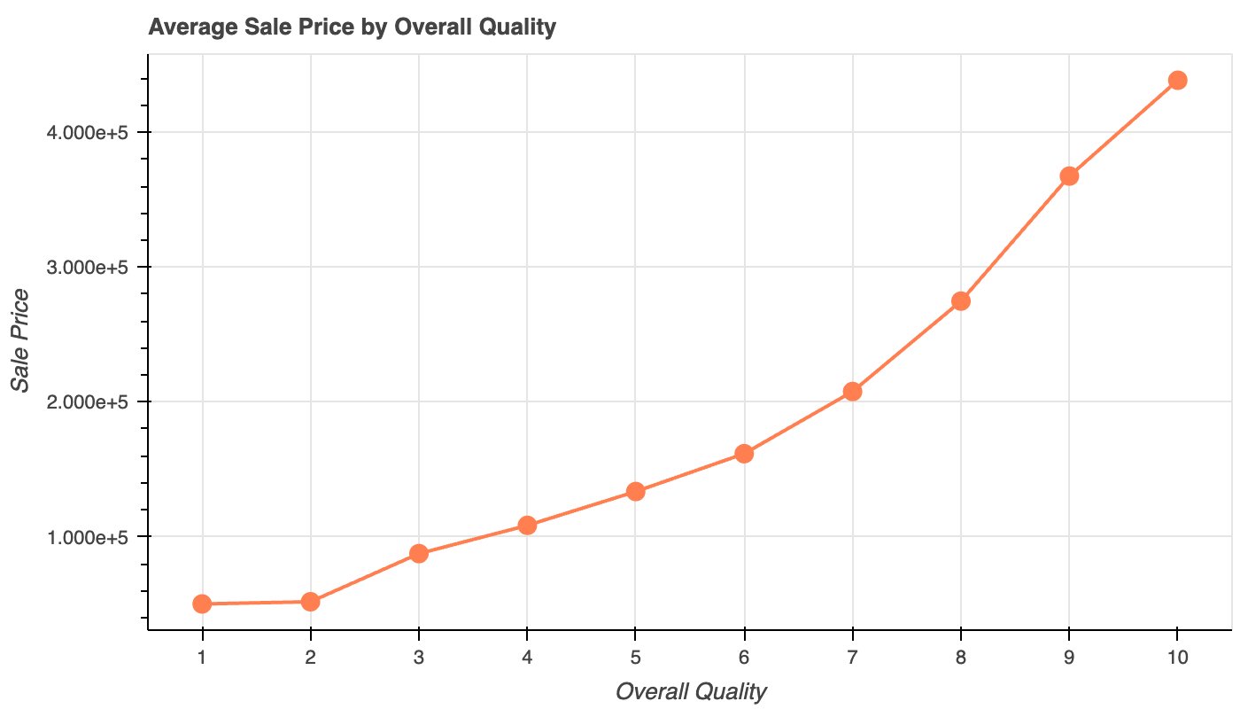
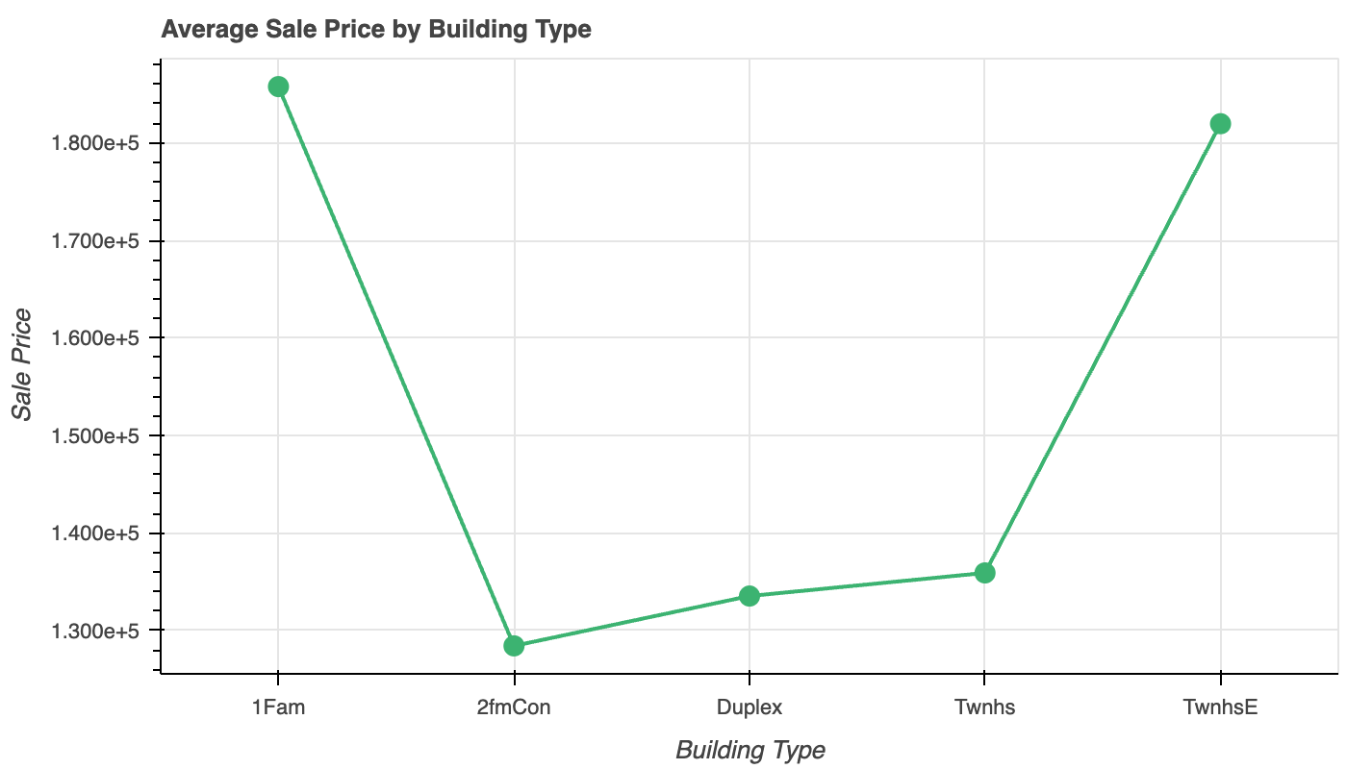
The three average sales graphs reveal how location (neighborhood), quality rating, and building type each impact house prices, showing that quality has the strongest linear relationship while neighborhoods show the widest price variation.

Slide 8
The Transformation
From Raw Data to Predictions
Our Data Pipeline:
1. Cleaning → Removed 5 columns with >50% missing data, imputed strategically, capped outliers (1st-99th percentile)
2. Feature Engineering → Created 10 powerful new features:
TotalSF (total square footage)
PropertyAge, RemodAge
QualityScore (quality × condition)
TotalBath, TotalPorchSF
Binary flags (HasGarage, HasBasement, etc.)
3. Feature Selection → Multi-method approach:
Started with 81 features
Filtered to 35 using Mutual Information, F-test, Random Forest
Refined with RFECV (24 features) and Lasso (23 features)
Final: 35 best features selected
4. Dimensionality Reduction → PCA reduced to 20 components (95% variance retained)

Slide 9
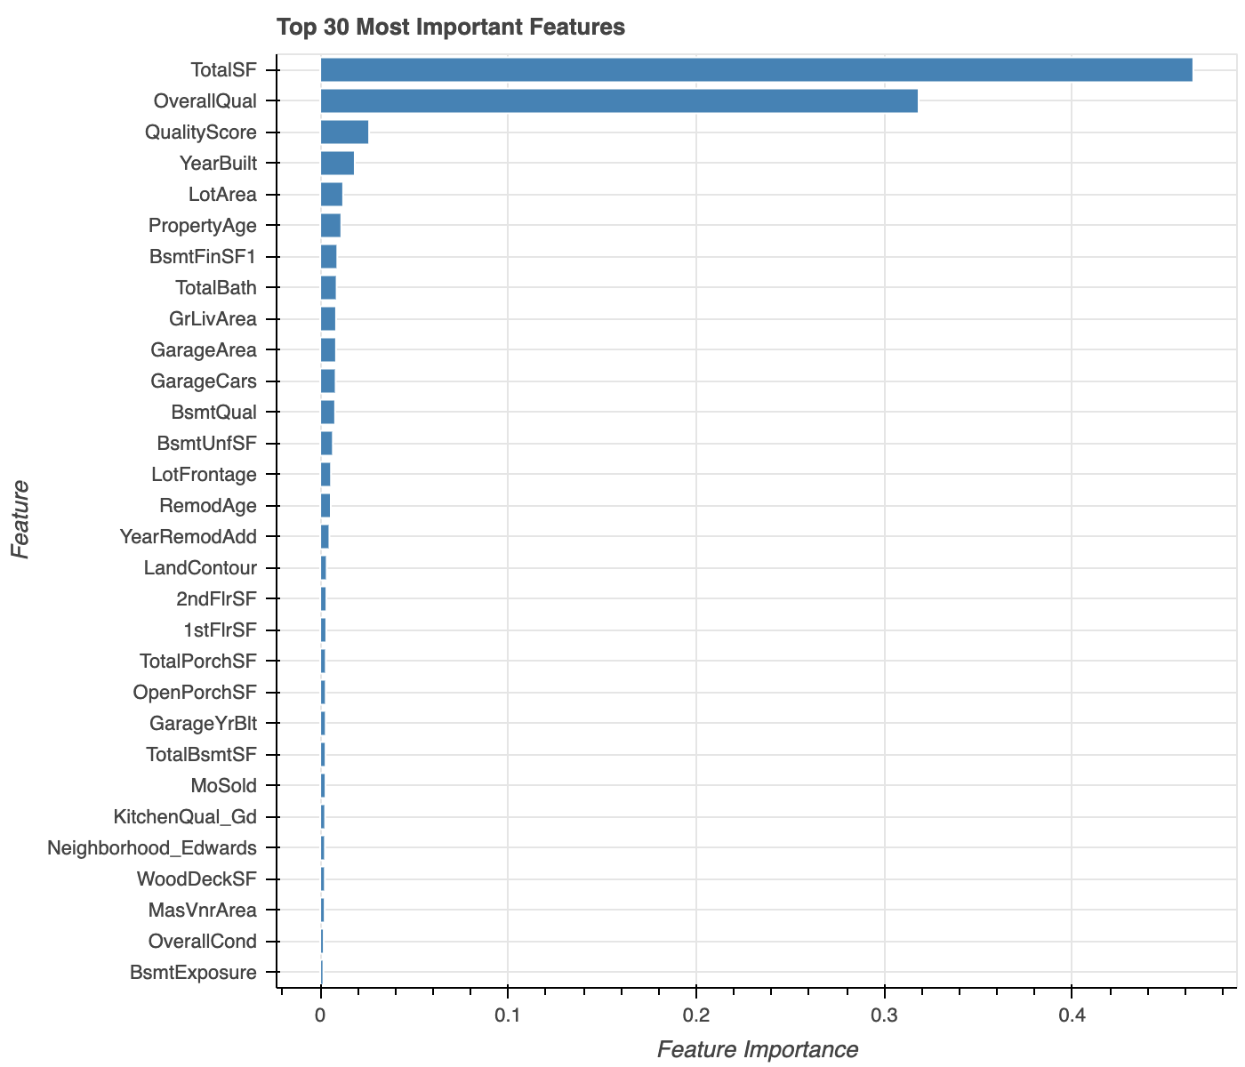
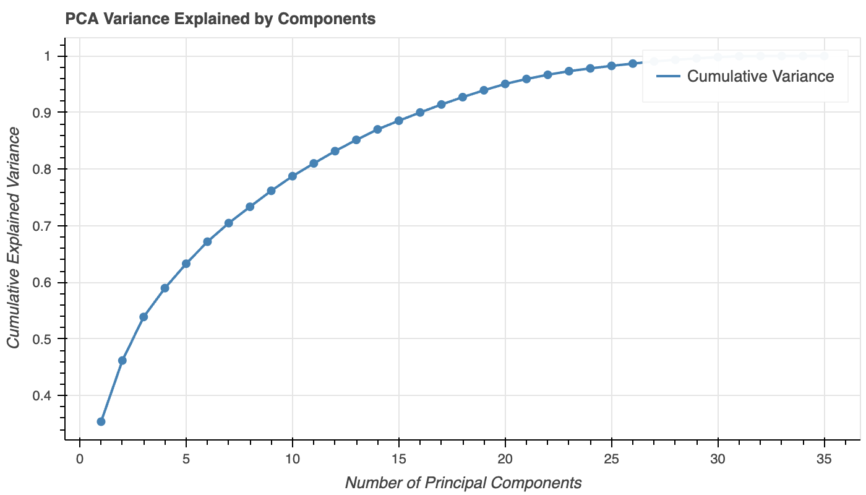
PCA
Number of components to retain 95%
Variance: 20
Reduced shape: (1460, 20)

Slide 10
The Solution
Four Models, One Winner
Models Tested:
Gradient Boosting ⭐ (Best)
LightGBM
Linear Regression
Tuned SVR
Why Gradient Boosting Won:
Handles non-linear relationships
Captures feature interactions
Robust to outliers
Best performance on PCA-reduced features
Training Strategy:
Log-transformed target (normalized distribution)
80/20 train-test split
PCA-reduced features (20 components)
Hyperparameter tuning for SVR

Slide 11
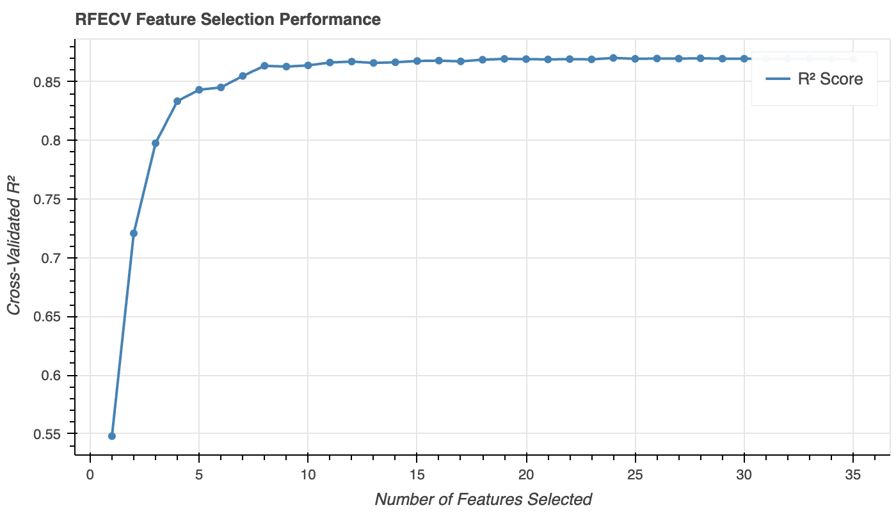

Slide 12
The Results
90.4% Accuracy Achieved
Model | R² Score | RMSE (log) | Performance
Gradient Boosting | 0.9043 | 0.1267 | Best
LightGBM | 0.9001 | 0.1295 | Excellent
Linear Regression | 0.8942 | 0.1333 | Good
Tuned SVR | 0.8801 | 0.1419 | Good
What This Means:
Model explains 90.4% of price variance
Predictions are within 12.7% error (log scale)
Top 3 models all exceed 89% accuracy
Robust and reliable predictions

Slide 13
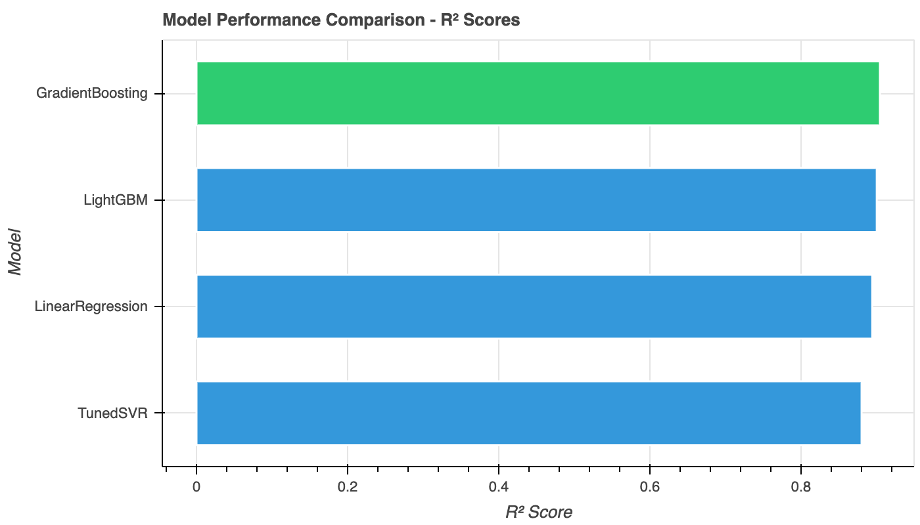
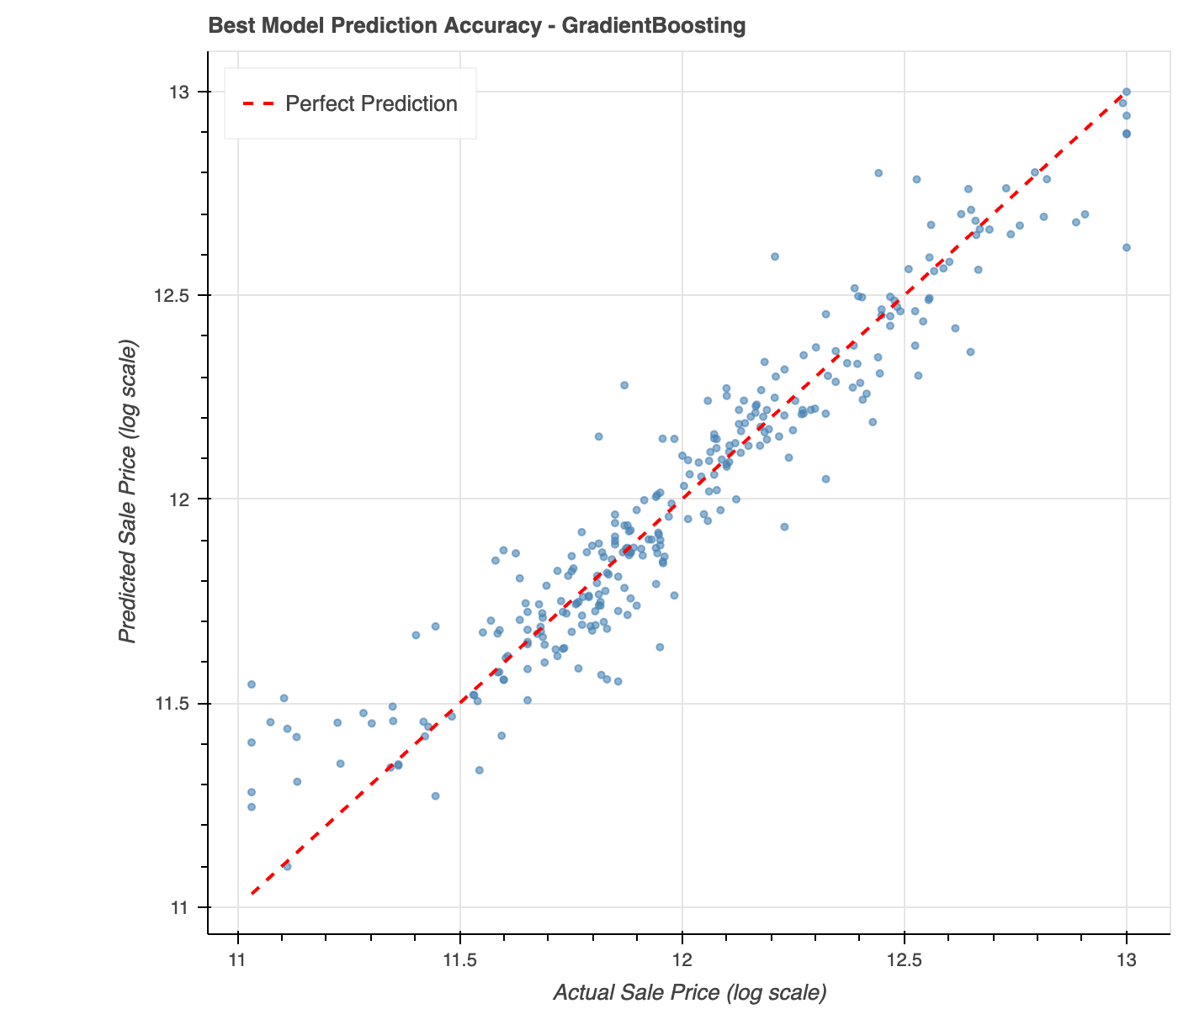
R² Chart: Gradient Boosting leads with 90.4% R², outperforming all other models.
Scatter Plot: The tight clustering of points around the diagonal line confirms the model accurately predicts house prices across all price ranges.

Slide 14
The Insights
What We Learned About House Prices
Top 5 Price Drivers:
Total Square Footage (46.4% importance)
Overall Quality (31.8% importance)
Quality Score (2.6% importance)
Year Built (1.8% importance)
Lot Area (1.2% importance)
Business Recommendations:
Size investments yield highest ROI
Quality improvements significantly boost value
Age matters but can be offset by quality
Location matters less than quality and size
15 Features consistently selected across all methods:
TotalSF, OverallQual, GrLivArea, GarageArea, TotalBath, and 10 more

Slide 15
Total unique selected features: 35
Total features after PCA: 20
Highly consistent across all methods: 15
Common features across ALL methods:
['BsmtFinSF1', 'BsmtQual', 'Fireplaces', 'GarageArea', 'GarageCars', 'GrLivArea', 'KitchenQual_TA', 'LotArea', 'MSSubClass', 'OverallQual', 'PropertyAge', 'QualityScore', 'RemodAge', 'TotalBath', 'TotalBsmtSF']

Slide 16
The Impact
From Data to Decisions
What We Built:
Complete ML pipeline (data → predictions)
90.4% accurate price prediction model
Multi-method feature selection approach
Production-ready model (saved as .pkl)
Real-World Applications:
Real Estate: Instant property valuations
Banking: Automated loan assessments
Investors: Identify undervalued properties
Market Analysis: Understand price drivers
Key Achievement:
Transformed 81 messy features into 35 powerful predictors, achieving 90.4% accuracy with Gradient Boosting.

Slide 17
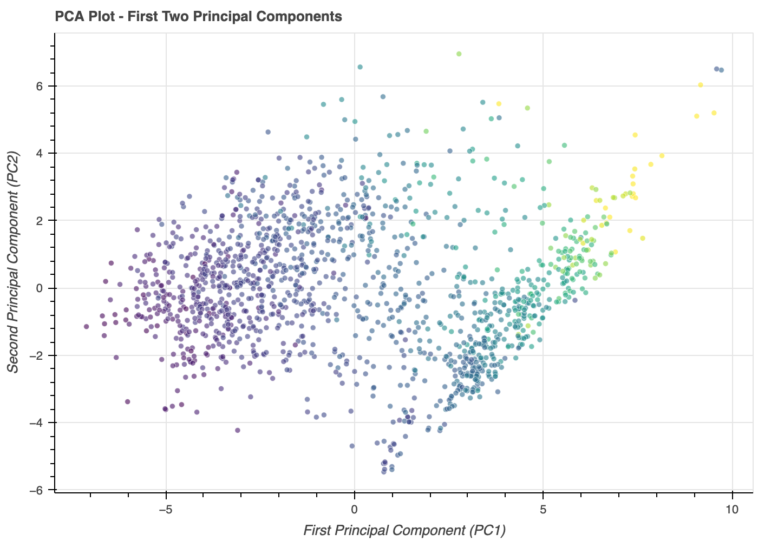

Slide 18
Validation Results Export
(house_price_validation_results.csv)
Detailed Performance Analysis
What We Exported:
292 validation samples analyzed in detail
Per-sample predictions with comprehensive error metrics
Complete validation results saved to CSV for further analysis
Key Metrics in Export:
Actual vs Predicted prices (log scale)
Error distribution (raw and absolute)
Percentage errors for interpretability
Absolute percentage errors for magnitude assessment
Validation Insights:
Model performance validated on 20% hold-out test set
Each prediction includes error breakdown
Enables detailed analysis of model behavior
Supports production deployment validation

Slide 19
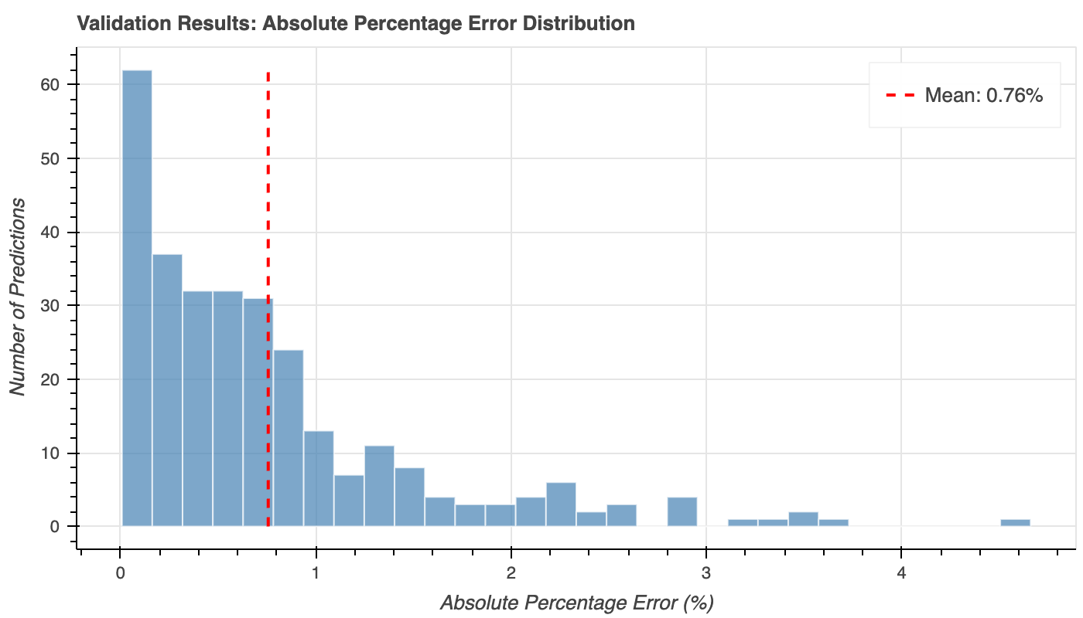
Key Findings from Validation:
Mean Absolute Percentage Error: 0.76%: Excellent average accuracy
Median Absolute Percentage Error: 0.54%: Most predictions are highly accurate
95th Percentile: 2.35% - 95% of predictions within 2.35% error
Max Error: 4.66%: Worst case scenario still under 5% error

Slide 20
Conclusion
The Story in Numbers
Project Summary:
460 houses analyzed
81 features → 35 selected → 20 PCA components
4 models tested
90.4% accuracy achieved
Gradient Boosting as best model

Slide 21
Thank you!

Slide 22
Team Details
Team Members
Shivansh Tiwari
Pathaneni Gangotri
Sonkar Vedant Rajesh Ranjeeta
Himanshu Soni
Team Supervisor
Utkarsh Khare

